Slide 1

Testbed to Simulate & Analyze RCPS
Pranav Srinivas Kumar, William Emfinger, and Gabor Karsai
This work was supported by DARPA under contract NNA11AB14C and USAF/AFRL under Cooperative Agreement FA8750-13-2-0050, and by the National Science Foundation (CNS-1035655). Any opinions, findings, and conclusions or recommendations expressed in this material are those of the author(s) and do not necessarily reflect the views of DARPA, USAF/AFRL, or the NSF.

Slide 2
Introduction
Developing software for Distributed CPS is hard
Specialized Hardware and Control
Rigorous testing before deployment – Design-time Guarantees
Performance assurances, reliability, fail-safety etc.
UAV/UUV systems, fractionated spacecraft, autonomous vehicles
Difficult to obtain public access to implementation details
Pure simulation of protocols and control algorithms is not exhaustive
Comprehensive testing requires replicating the CPS using a testing platform providing similar hardware and embedded control code as the real system deployment

Slide 3
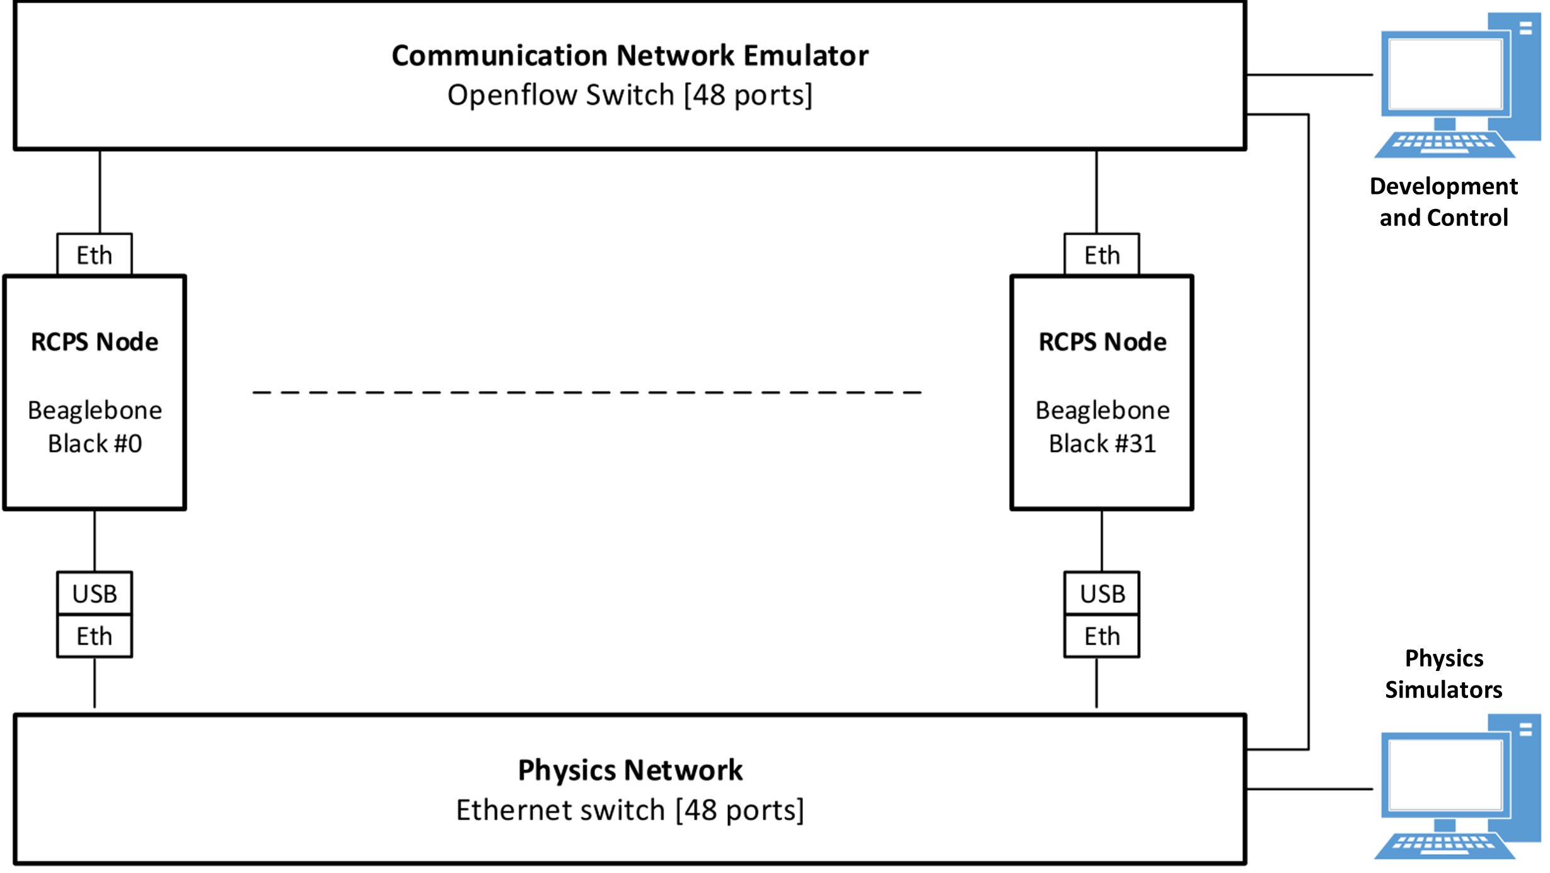
Testbed Architecture

Slide 4
RCPS Testbed Overview
Embedded hardware running component-based application code – actual code that would run in the real CPS
Physical system simulator that simulates the physics of the physical system, all sensors, all actuators and the environment
Code running on the hosts communicates with the physics simulator to get current sensor state and to control the actuators
Smart network switch (using OpenFlow) allows the emulation of network resources to accurately emulate the system’s network
Integrated analysis and measurement tools for testing CPS apps
Modeling tools, code generators, and deployment/monitoring utilities mean we spend more time on testing and less time on infrastructure issues

Slide 5
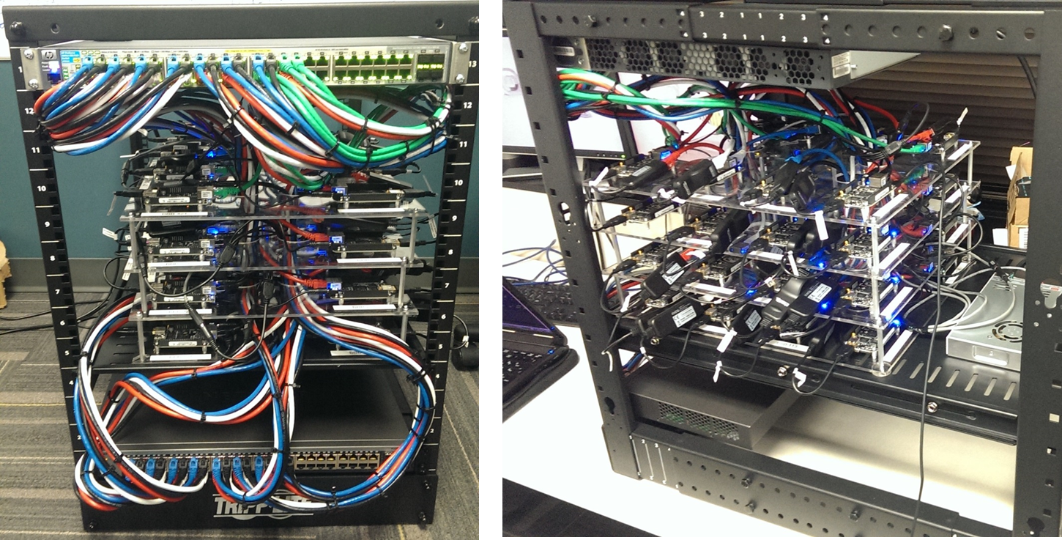
RCPS Testbed Overview

Slide 6
Use Cases
Security
Algorithms: Deploy appliations that test various distributed algorithms e.g. consensus algorithms designed to address the Byzantine Generals problem, and measure the speed of convergence of interactions with system faults and resilience counter measures
Infrastructural: Test different attack vectors for, e.g., gaining unauthorized access to the file systems, bringing down hosts, or compromising nodes.
Resilience
Introduce faults into the system, e.g. sudden host failure, sudden network failure, etc. and measure how the system and its applications respond to the faults
Analysis
Validate analysis models and develop more precise models of interaction patterns for anomaly detection, e.g. DDoS network traffic profiles versus stable system network traffic profiles.

Slide 7
Preliminary Experiments
Utility in sensing, actuation and control of dynamic CPS scenarios
Testing Parameters
Robot Operating System Middleware
CBSE Code Design Principles
High Fidelity Physics Simulation Machine with I/O interfaces
Development Machine with network access to all RCPS nodes
Apps have direct access to physics sim sensors, emulating reality
Log real-time activity to aid monitoring infrastructure
Mission and Safety-critical CPS scenarios
Orbiter Space Flight Simulator
Kerbal Space Program
SUMO

Slide 8
Orbiter Space Flight Simulator
We have 32 RCPS nodes running component-based flight software
Cluster Flight Control: handles cluster trajectory and management
Satellite Flight Control: Retrieves satellite state from sensors, actuates satellite thrusters and communicates internal state to all other satellites
Wide-area Monitoring: Imaging applications with distributed camera sensors to produce processed images
RCPS nodes maintain coordinated cluster flight
Cluster scatters on reception of an emergency scatter command
Applications run on our testbed under ROS integrating with Orbiter
Send scatter command at random intervals to cluster leader
Dissemitate command to rest of cluster
Satellites scatter – seen in Orbiter

Slide 9
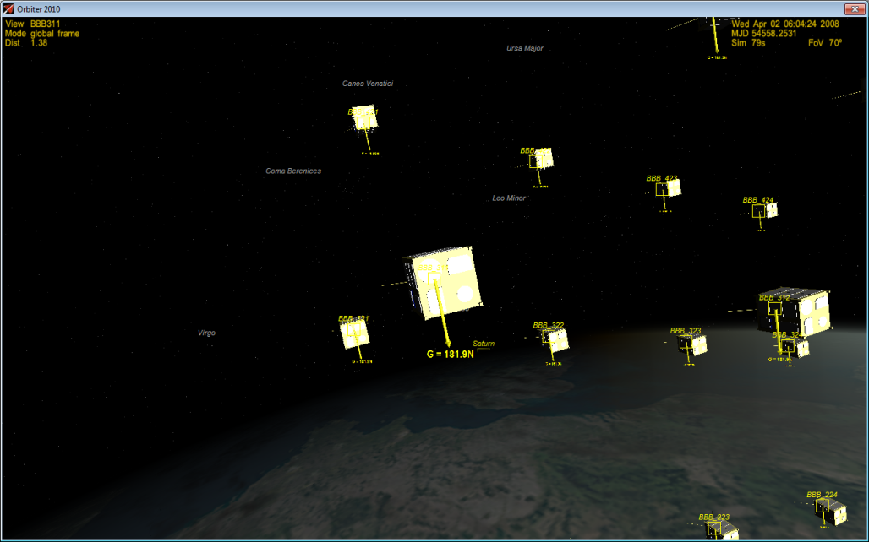
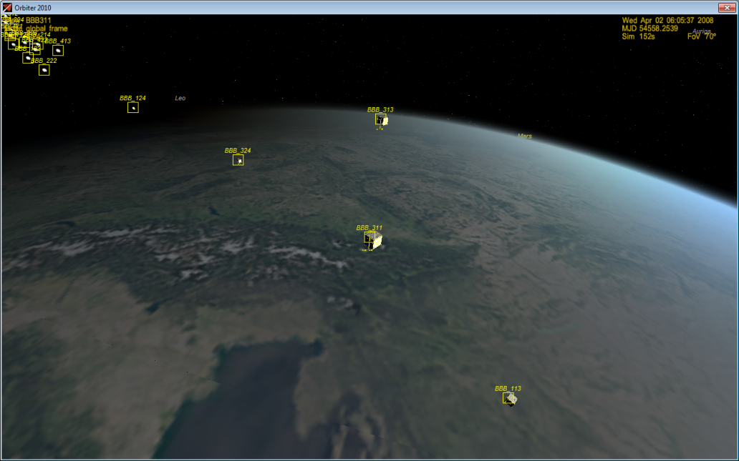
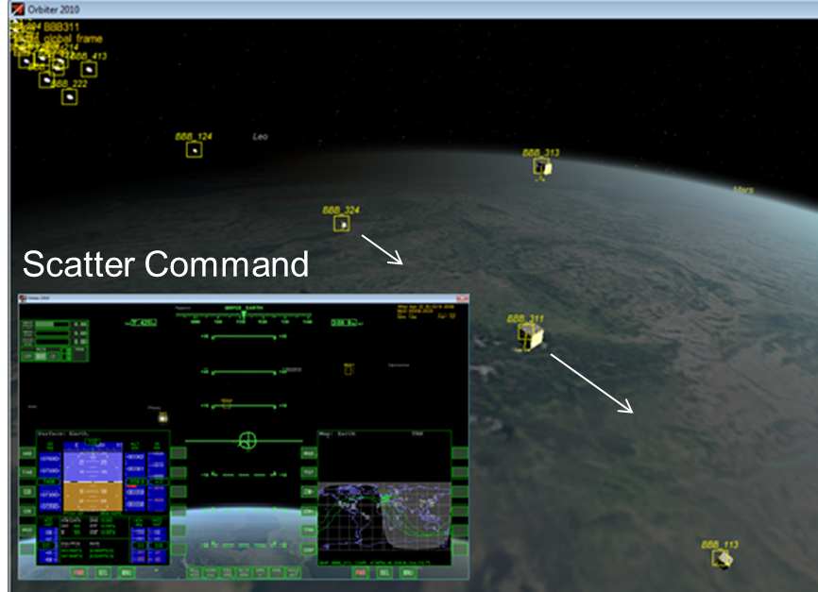
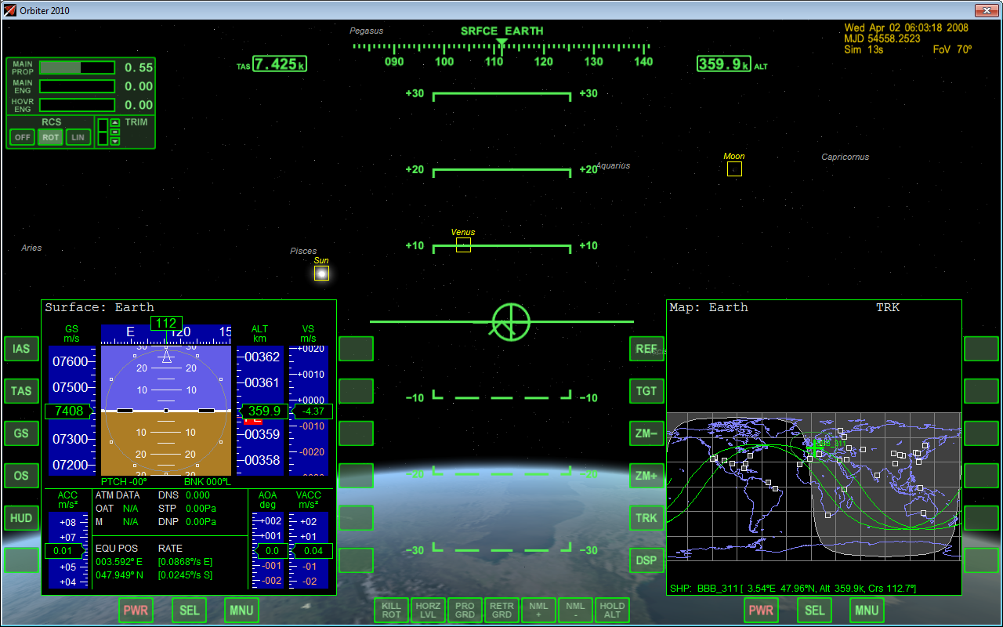
Orbiter Space Flight Simulator

Slide 10
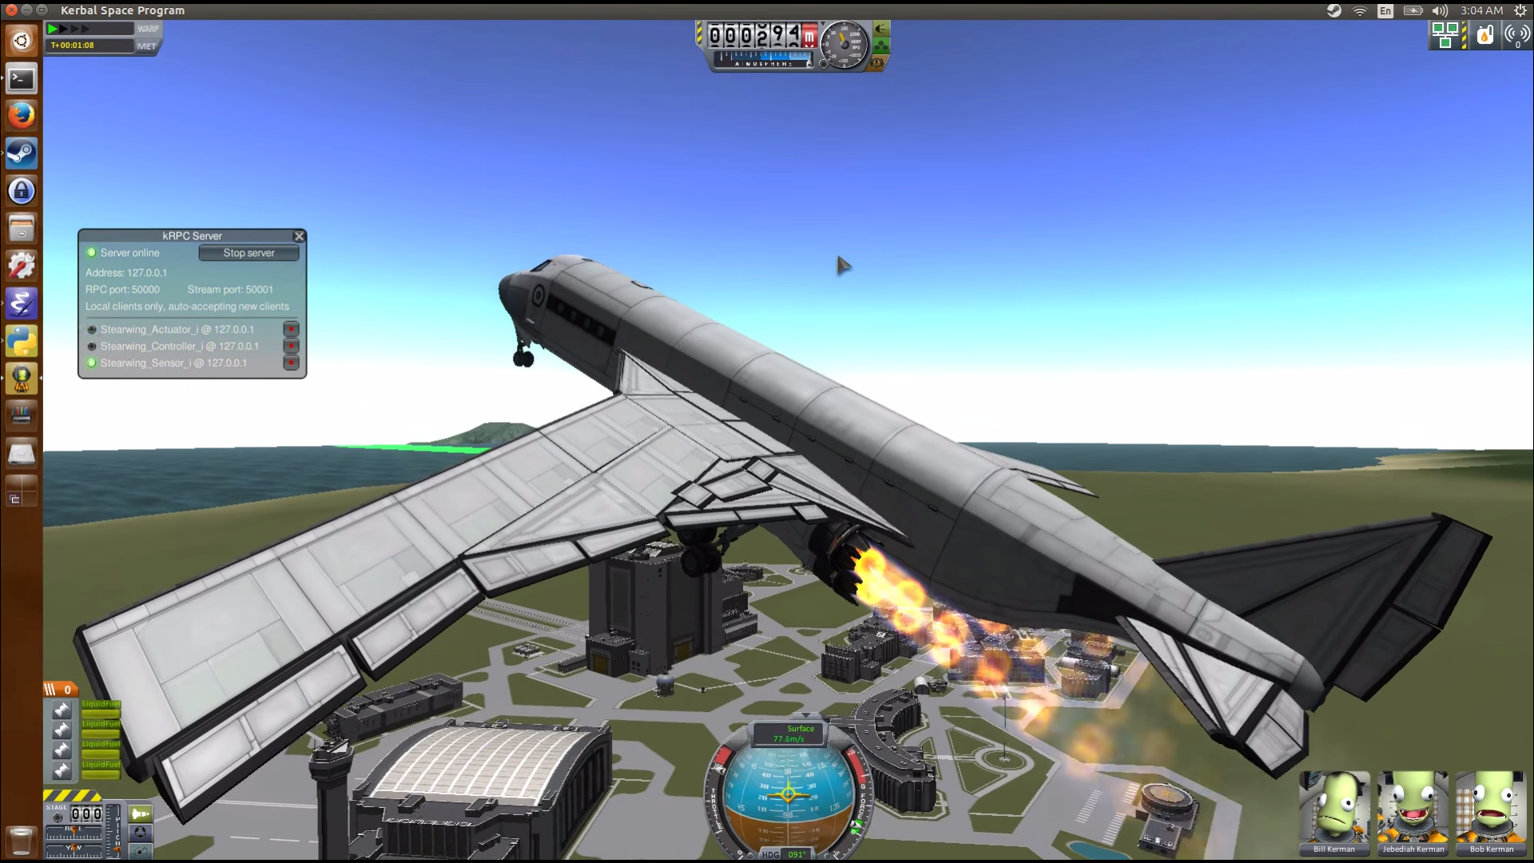
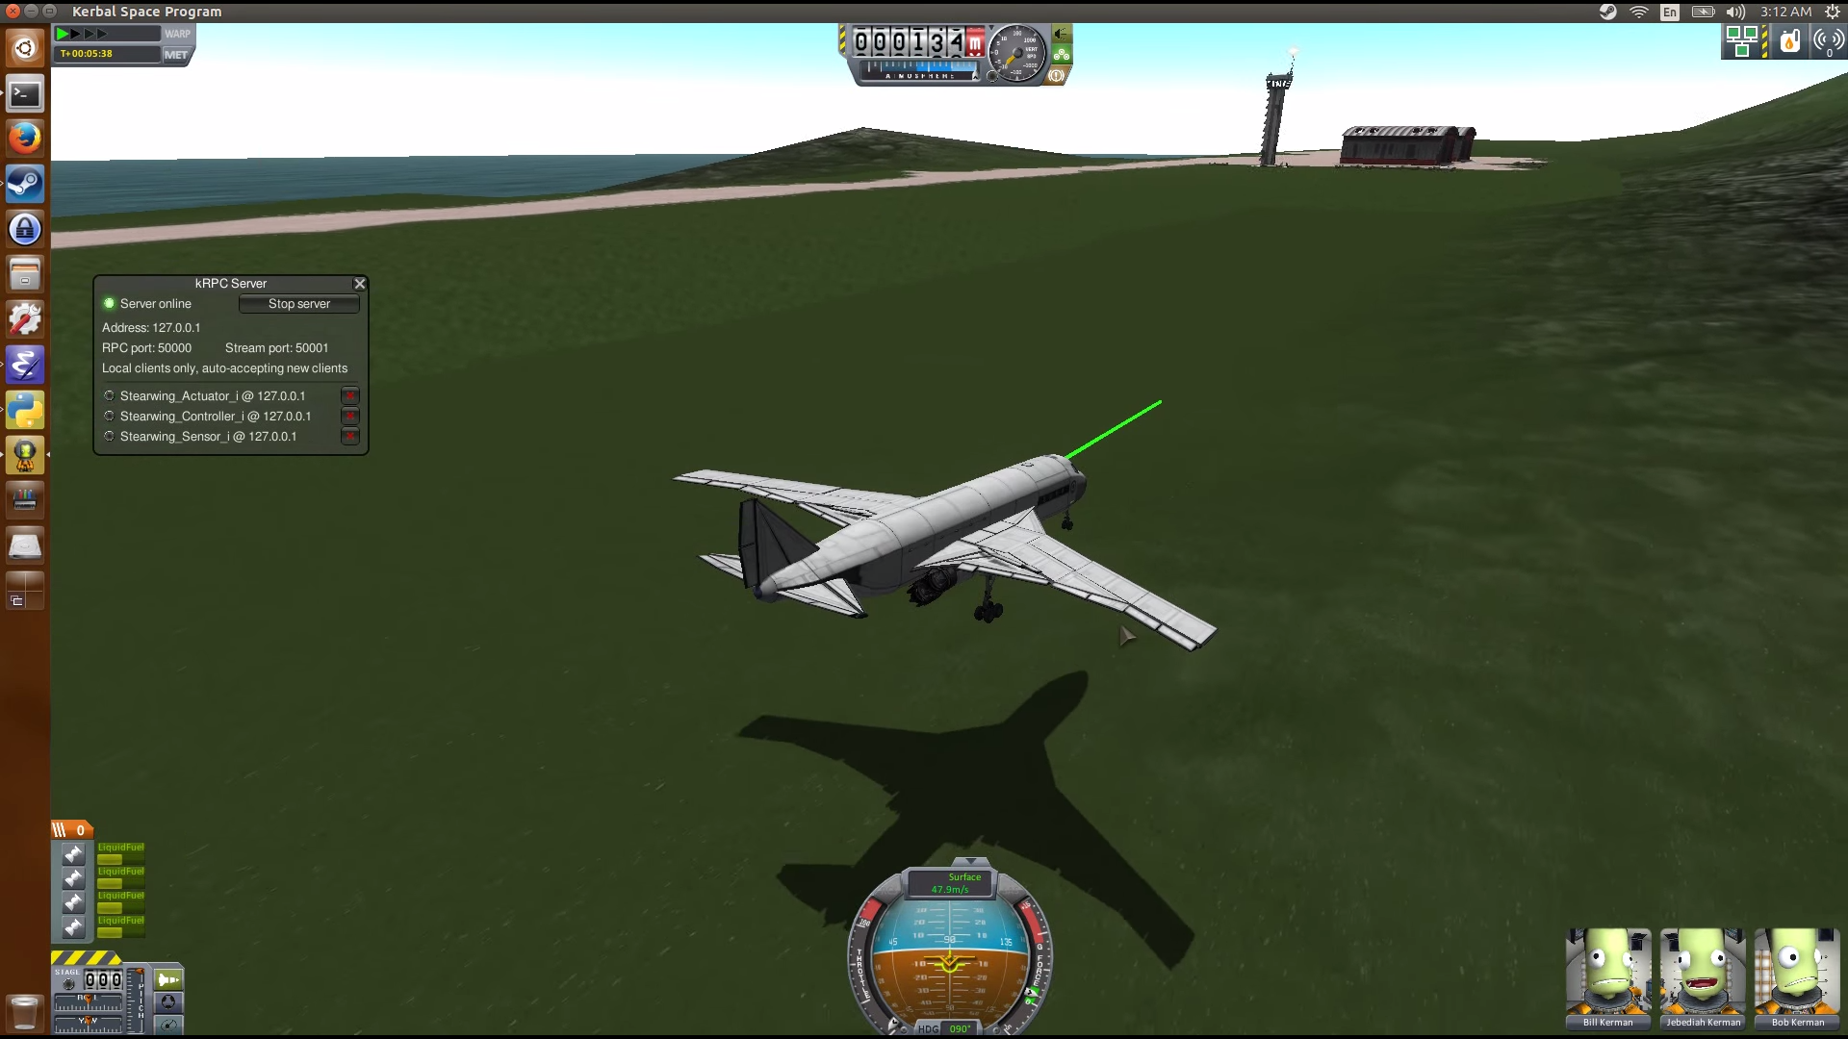
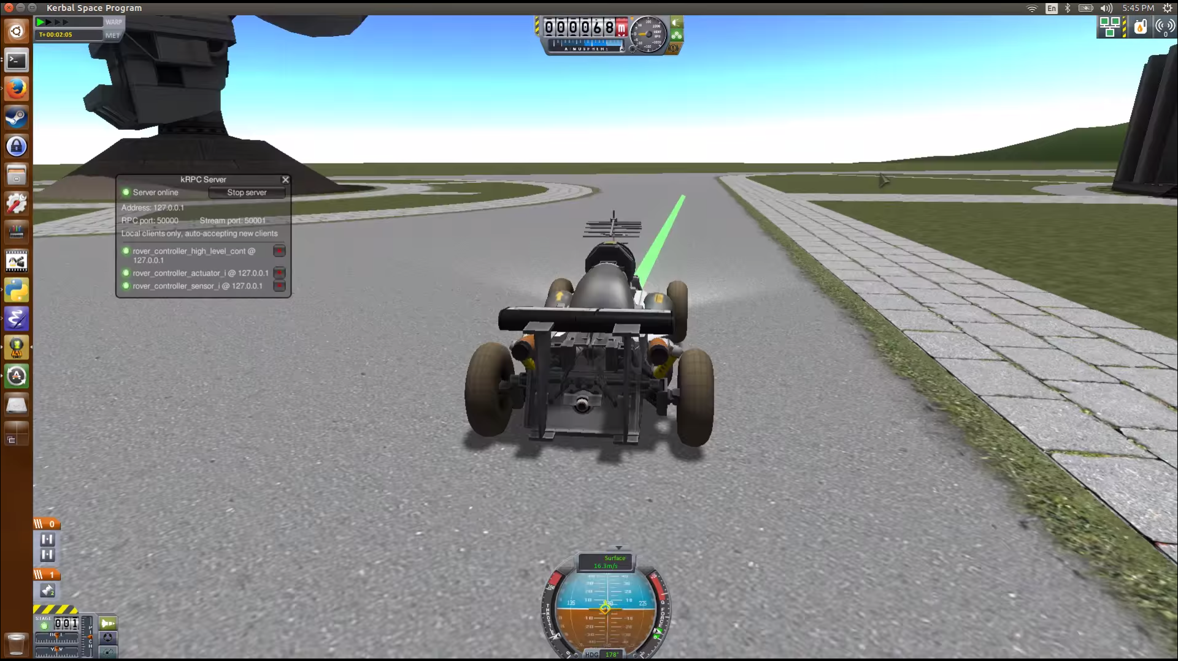
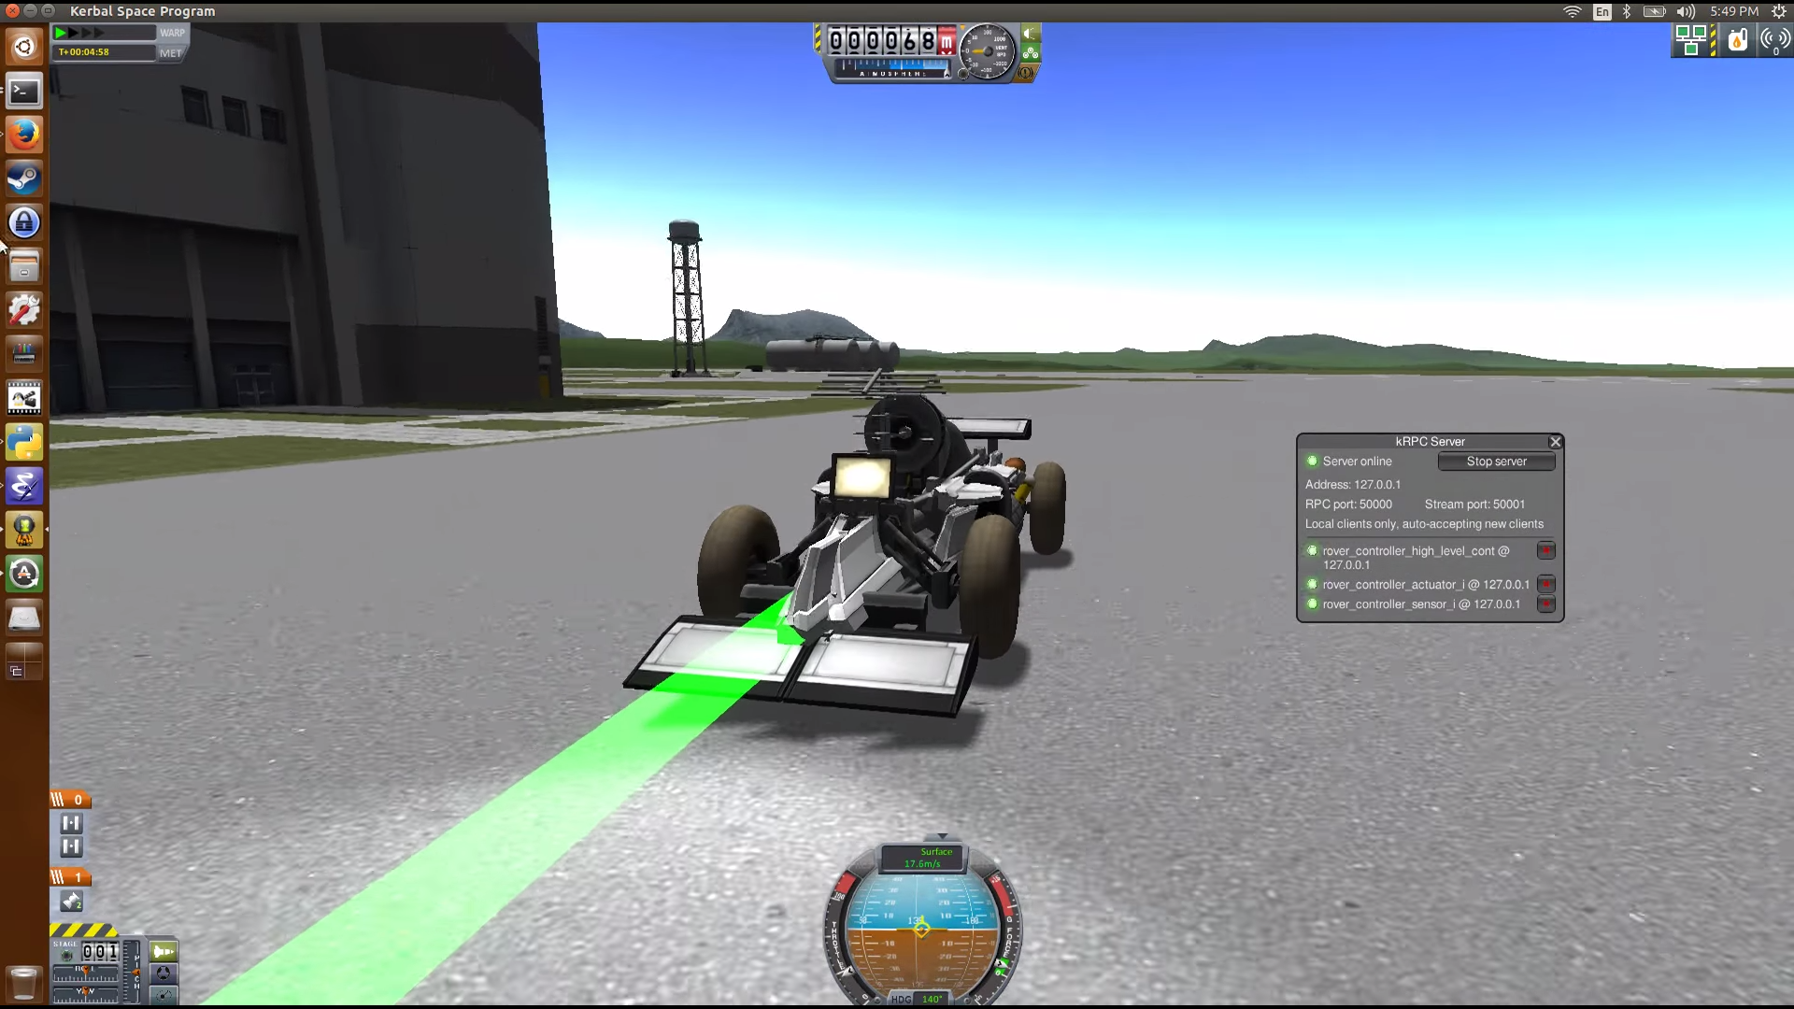
Kerbal Space Program – Autonomy & Control

Slide 11
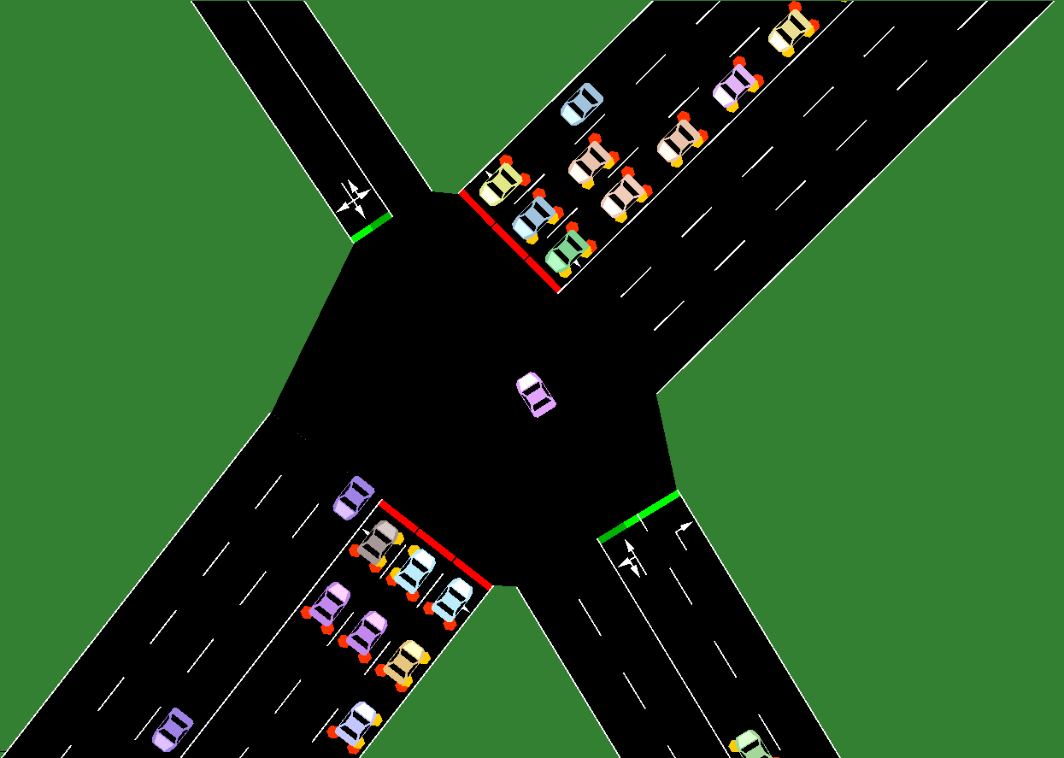
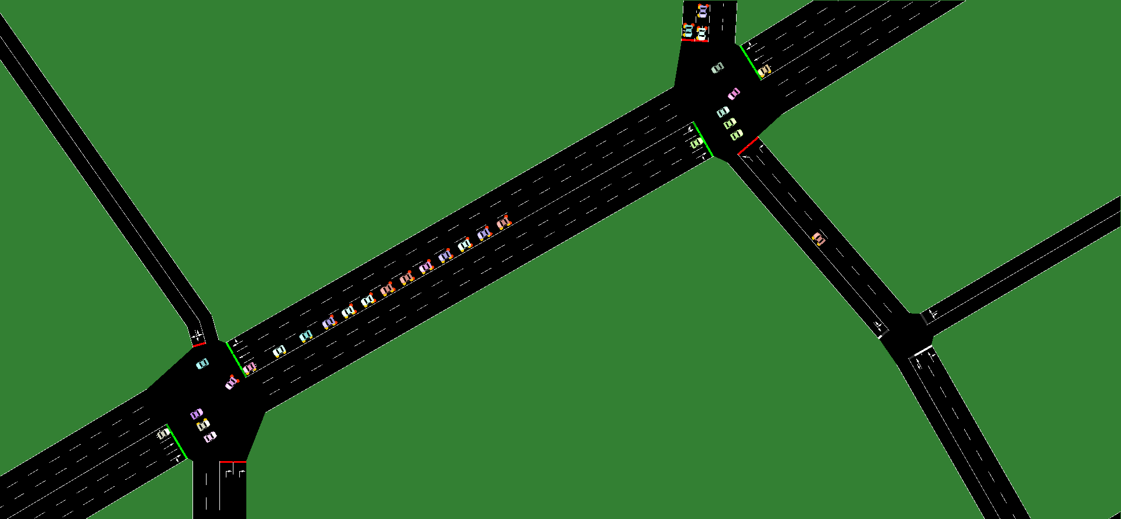
SUMO – Resilient Sensing to Cyber-Attacks
Deploy sensors, actuators, and controllers on the network
Attack specific groups or the system overall with e.g. DDoS
Analyze how the application and system responded to the attacks
Develop optimal sensor/actuator placement and network configuration for resiliency against faults and attacks
Traffic Light Controller Component
Inductive Loop Sensor Component
Traffic Light Actuator Component

Slide 12
Conclusions
The RCPS testbed provides a HIL testing facility for experimentation with CPS code and system prototypes against real-time physics simulator(s) and an embedded network
The testbed is supported by a model-based development environment for the rapid construction and deployment of CPS application software
The flexibility of the physics simulation and the network emulation enables the execution of complex testing and evaluation scenarios

